Slide 1

Sidmouth College
Believe • Inspire • Succeed

Slide 2

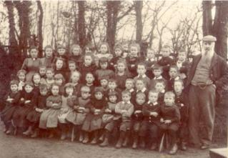
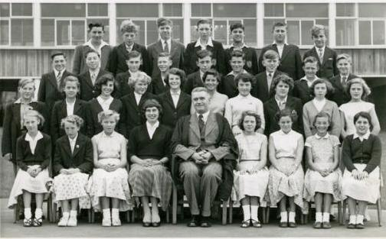
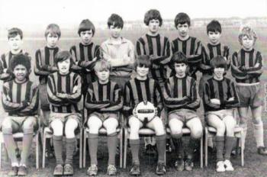
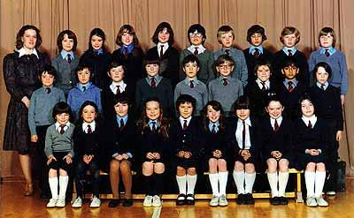

Discussion
Sidmouth College
Believe Inspire Succeed
What are your strongest memories of your own secondary school?
What do you think it provided for you as a pupil?

Slide 3
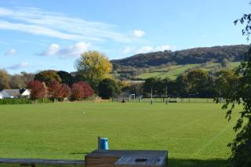
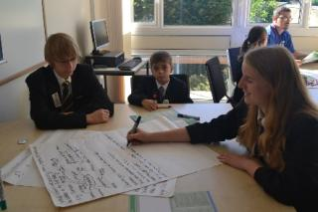
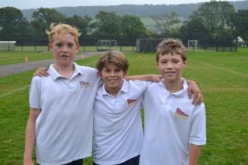
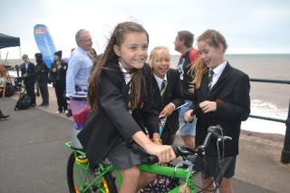
GCSE Subject Performance
Sidmouth College
Believe Inspire Succeed
GCSE Results – Both attainment & progress continue to improve and have been ABOVE national average for the past three years.
Old Government Measure for 2015-16
Students achieving: 5 A*- C including English & Mathematics = 64%
Students achieving: 5 A* - C = 73%
New Government Measures for 2016-17
Students achieving a Pass in English & Mathematics = 58%
Progress 8 – 0.20 (Performance in students’ best 8 subjects)
A Level Results – Both attainment & progress continue to improve with 100% achieving A*-E grades
Students achieving A*-B = 61%
Students achieving A*-C = 90%
Progress – Positive Value Added Score 0.14

Slide 4
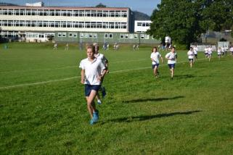
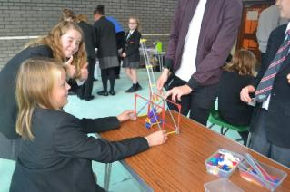
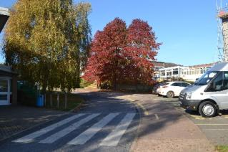
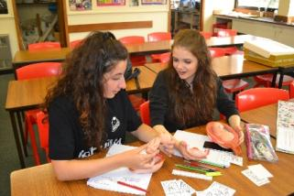
OFSTED Recognition
Sidmouth College
Believe Inspire Succeed
Section 8 inspection took place on Tuesday 18th October 2016
Inspection undertaken under a new inspection framework – more challenging
Extremely positive inspection – Outcome that the College received was in line with the College’s self evaluation.
“ Pupils are a delight”
“Behaviour is a real strength”
“Strong attitudes towards learning”
“ Safeguarding permeated the school and is a real strength”
“The College has clear expectations of learning”
“ Lessons are well planned to ensure strong pupil progress”
“All groups of students including disadvantaged are making good progress”
“ The strong pastoral system ensures all students are cared for”
“ Have a feeling that there is a real sense of urgency and things have picked up since September”

Slide 5
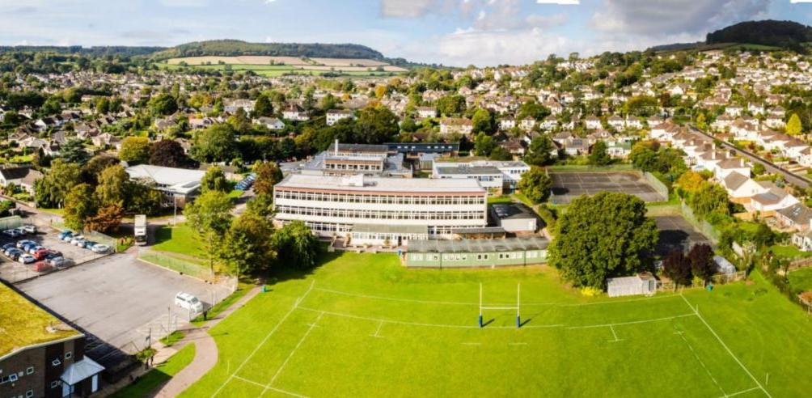
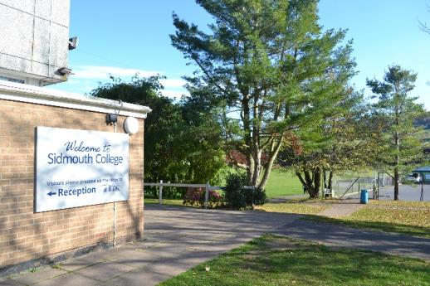
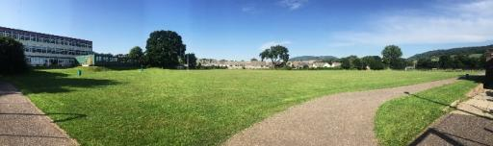
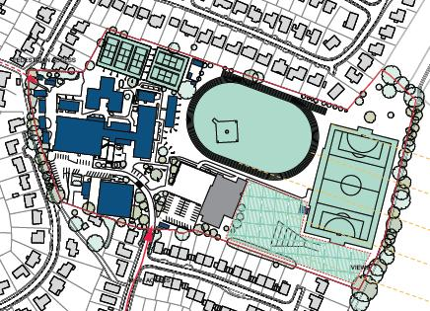
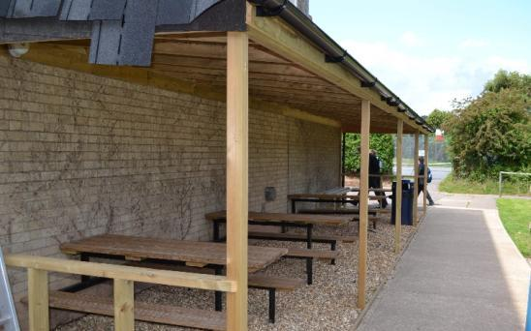
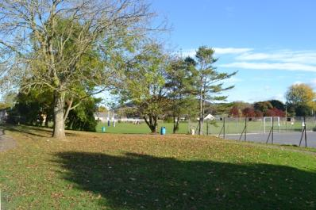
The College Campus
Sidmouth College
Believe Inspire Succeed

Slide 6
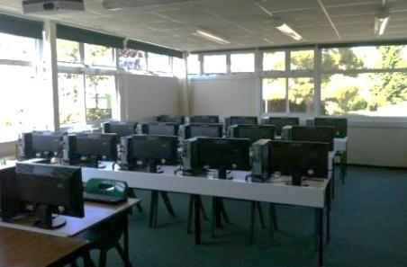
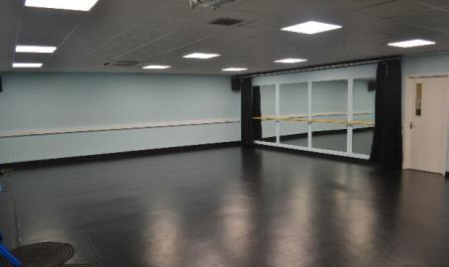
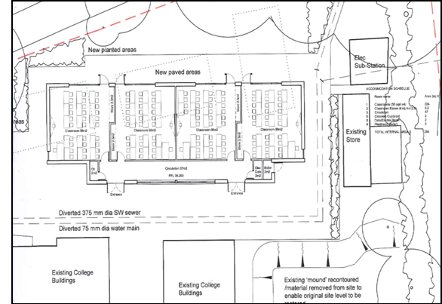
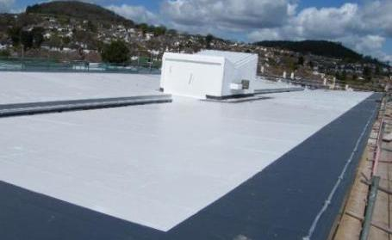
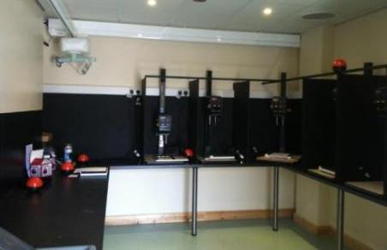
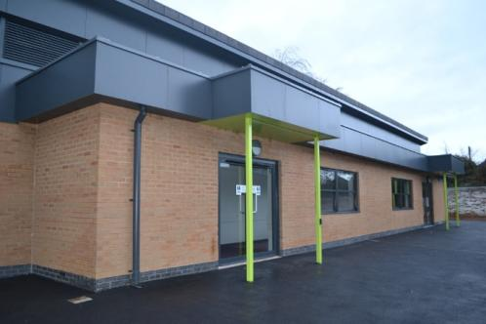
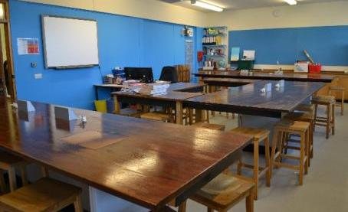
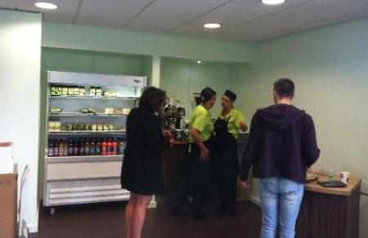
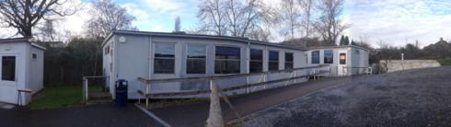
Campus developments
Sidmouth College
Believe Inspire Succeed
Mathematics Block
Drama & Dance Studio
Media Studies Suite
Replacement College Roof
Photography Suite & Darkroom
Refurbished Science Labs
Café 6

Slide 7
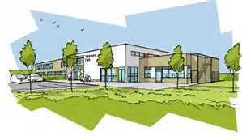
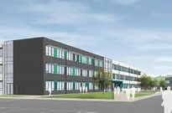
Priority Schools Build Programme
Sidmouth College
Believe Inspire Succeed
Only one of 11 Schools in the South West to be chosen as part of the Priority Schools Building Programme
Complete refurbishment or rebuild of the College Campus (Currently in the Feasibility stage)
This will provide state of the art facilities and improve the majority of the College Campus
Start date – July 2018 (12-18 months build time)
Watch this space development at the College which is very exciting!

Slide 8
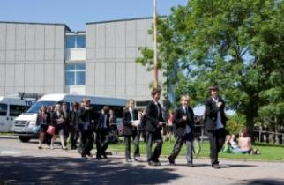
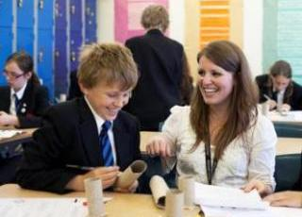
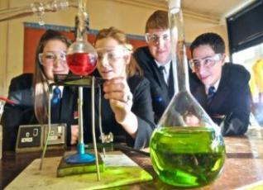

Curriculum + Assessment
Sidmouth College
Believe Inspire Succeed
3 years of Key Stage 3
2 years of Key Stage 4
Core Subject setting from Year 9
Focus on Quality First Teaching - Differentiation
Route Setting – reviewed annually – Challenge.
Regular Reporting (Interim and Profiles)
Student Development Department
Key Stage Coordinators

Slide 9
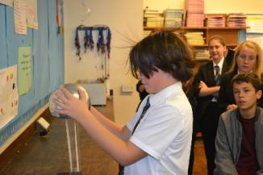
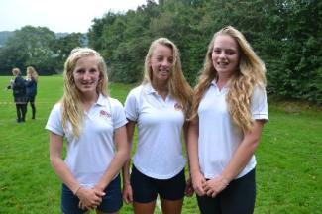
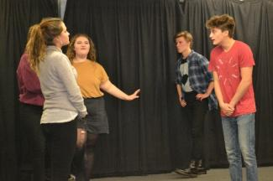
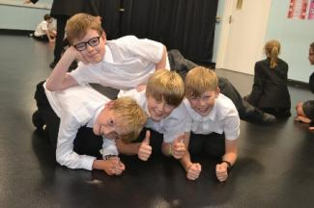
Target Setting – Routes to Success
Sidmouth College
Believe Inspire Succeed
Routes to Success – New Target Setting and Assessment Process , plotting your child’s route through KS3 in to KS4 using GCSE grading criteria.
How do we decide on these Targets / Routes?
End of KS2
Teachers
Gov
End of Year
Challenging
Reviewed each Year

Slide 10
The College Day
Sidmouth College
Believe Inspire Succeed
Lessons are arranged over a 2 week “cycle” with 50 one hour lessons per cycle. In Year 7 these lessons are:
English | 6 | History | 3
Maths | 6 | Geography | 3
Science | 6 | Art & Design | 2
French | 5 | Drama | 2
Design Technology | 4 | Music | 2
Physical Education | 4 | ICT | 2
Religious Education | 3 | Personal Development | Tutorial

Slide 11
The College Day
Sidmouth College
Believe Inspire Succeed
Tutorial/Assembly | 8.50am – 9.15am
Period 1 | 9.15am - 10.15am
Period 2 | 10.15am – 11.15am
Morning Break
Period 3 | 11.35am – 12.35pm
Period 4 | 12.35pm – 1.35pm
Lunch
Period 5 | 2.20pm – 3.20pm

Slide 12
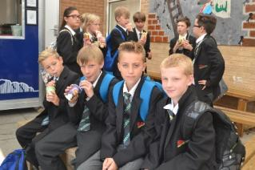
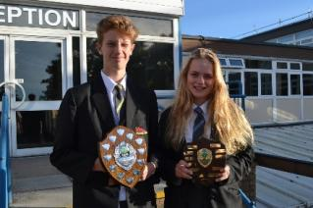
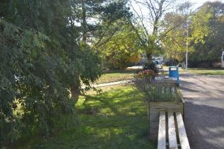
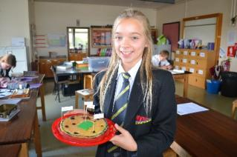
Student Support
Sidmouth College
Believe Inspire Succeed
House System
All students are allocated into one of four vertical Houses comprising Yr7-11 .
A tutor and HOH look after you and stay with you for five years.
Raleigh
Drake
Grenville
Scott
Student achievements, progress and success is regularly rewarded through awarding House points.

Slide 13
The Sidmouth College Way
Sidmouth College
Believe Inspire Succeed

Slide 14
Admission Application Arrangements –Y5
Sidmouth College
Believe Inspire Succeed
Date | Admission Activities
September 2018 | College prospectus available
 | Application details sent out
 | Open Day & Open Evening
31st October 2018 | Closing date for 2019 Year 7 admissions. Applications returned to Devon County or completed online.
March 2019 | National offer day – offer of placement sent to parents
31st March 2019 | Closing date for appeals
April - June | Sidmouth College pastoral visits to Primary Schools
June | SEN Induction Days
July | Student placement into Form groups + Houses
 | Sidmouth College Induction Days + Parents Evening
July/August | Summer School
September 2019 | Students begin Year 7 at Sidmouth College

Slide 15
Admissions Criteria
Sidmouth College
Believe Inspire Succeed
Looked After Children.
Children who live within the priority admissions area and who attend the following main feeder primary schools.
Children who live within the designated area with a sibling attending the College in Years 7-10 at the time of application and date of proposed admission.
Children residing outside the designated area who attend one of the feeder primary schools.
Children residing within the designated area who do not attend one of the above feeder primary schools.
Children who live outside the designated area with a sibling attending the College in Years 7-10 at the time of application and date of proposed admission.
All other applications.
Branscombe Primary | Newton Poppleford Primary
Sidbury Primary | Sidmouth

Slide 16
Yr 5 Opportunities to visit Sidmouth
Sidmouth College
Believe Inspire Succeed
Autumn 2
Tuesday 14th November 2017 | Sidmouth College Sporting Superstars Sports Hall and Gym 11.30-13.00
Spring 1
Thursday 1st February 2018 | Science - Investigating what the best conditions are for drying socks Lab 11 and Lab 15 10.30-12.15
Spring 2
Monday 26th March 2018 | Computer Science – Let’s get coding Room 49 and Room 53 10.30-12.15
Summer 1
Tuesday 1st May 2018 | Humanities – A Grab for Africa Room 2 and Room 7 10.30-13.00
Summer 2
Thursday 12th July 2018 | Drama Workshop- Mission Impossible Drama Studio and Room 30 10.30-12.15

Slide 17
Stakeholders’ Opinions of Sidmouth
Sidmouth College
Believe Inspire Succeed
Student Voice data 2016-17 (currently Yr. 8-12) (1618 RESPONSES)
Do you enjoy this subject? 80%
Do you feel you make good progress within this subject ? 85%
Are you aware of your target level/grade within this subject? 89%
Are you challenged within this subject? 88%
Does your teacher provide extension materials to ensure all students abilities are stretched? 78%
Is behaviour/engagement good within this subject? 85%

Slide 18
Stakeholders’ Opinions of Sidmouth
Sidmouth College
Believe Inspire Succeed
Parents – Feedback from Parents’ Evenings
2015/16 (229 parent carer responses)
92% of parents either agree or strongly agree that their child is taught well 4% disagree. 4 % don’t know.
2016/17 (357 parent care responses)
93% of parents either agree or strongly agree that their child is taught well
1% disagree. 6 % don’t know.

Slide 19
Open Evening 2017-18 - Feedback
Sidmouth College
Believe Inspire Succeed

Slide 20
Open Evening 2017-18 - Feedback
Sidmouth College
Believe Inspire Succeed

Slide 21
Questions?
Sidmouth College
Believe Inspire Succeed
Thank you for listening.
You are welcome to have a tour of the College at any point please you do not have to wait until Open Day/Evening. Contact the College Reception to make an appointment.
Do you have any questions?

